Slide 1

AI Searching Techniques
Introduction to Artificial Intelligence
Dr. Saif Ur Rehman

Slide 2
Today’s Lecture
Previous Week Recap
Informed Searching
Iterative DFS
Heuristically Informed Methods
Hill Climbing
Beam Search
Best First Search A*Procedure
Adversarial Search
Min-Max Procedure
Static Evaluation Function
Alpha Beta Pruning

Slide 3
Previous Week Recap!
In computer science, problem-solving refers to artificial intelligence techniques, including various techniques such as forming efficient algorithms, heuristics, and performing root cause analysis to find desirable solutions.
Search Algorithms Properties : Completeness, Optimality, Complexity, Space Complexity
Uninformed/Blind searching techniques Search through the space of possible solutions
Breadth-first search, Depth-first search, Uniform Cost, Depth-limited search, Iterative deepening depth-first search, Bidirectional

Slide 4
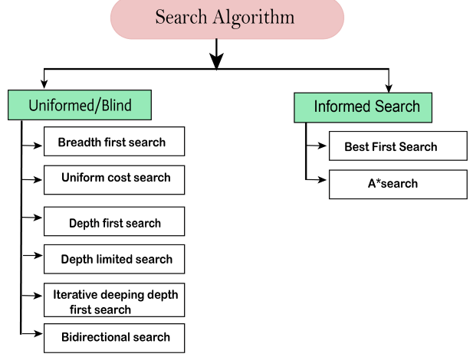
Types of Search Algorithms
Based on the search problems we can classify the search algorithms into uninformed (Blind search) search and informed search (Heuristic search) algorithms.

Slide 5
Types of Search Algorithms
Based on the search problems we can classify the search algorithms into uninformed (Blind search) search and informed search (Heuristic search) algorithms.

Slide 6
Informed Searching Techniques
“An informed search strategy—one that uses problem specific knowledge… can find solutions more efficiently then an uninformed strategy.”

Slide 7
Informed Searching Techniques
Uninformed search algorithms looked through search space for all possible solutions of the problem without having any additional knowledge about search space.
However, Informed search algorithm contains an array of knowledge such as how far we are from the goal, path cost, how to reach to goal node, etc.
Therefore, knowledge help agents to explore less to the search space and find more efficiently the goal node.
The informed search algorithm is more useful for large search space. Informed search algorithm uses the idea of heuristic, so it is also called Heuristic search.

Slide 8
Informed Searching Techniques
Additional information to guide the search
Uninformed search methods
use only the information from the problem definition; and
past explorations, e.g. cost of the path generated so far.
Informed search methods
incorporate additional measure of a potential of a specific state to reach the goal
a potential of a state (node) to reach a goal is measured through a heuristic function
Heuristic function is denoted h(n)

Slide 9
Informed Searching Techniques
Heuristics Function
Finds the most promising path.
It takes the current state of the agent as its input and produces the estimation of how close agent is from the goal.
The heuristic method, however, might not always give the best solution, but it guaranteed to find a good solution in reasonable time.
Heuristic function estimates how close a state is to the goal.
It is represented by h(n), and it calculates the cost of an optimal path between the pair of states.
The value of the heuristic function is always positive.

Slide 10
Informed Searching Techniques
Heuristics Function
Admissibility of the heuristic function is given as:
Here h(n) is heuristic cost, and h*(n) is the estimated cost. Hence heuristic cost should be less than or equal to the estimated cost.
h(n) <= h*(n)
h(n) <= h*(n)

Slide 11
Best First Searching Techniques
One of the simple Heuristic Search algorithm
Also called as Greedy best-first search algorithm
Always selects the path which appears best at that moment.
It is the combination of depth-first search and breadth-first search algorithms.
With the help of best-first search, at each step, we can choose the most promising node.

Slide 12
Best First Searching Techniques
It Works under the principle of exploring the goal node according to a specific rule.
Uses the heuristic function for the estimation of the specific rule in the problem domain.
Heuristic function is used for the determination of the distance between the nodes.
Uses the two lists which are the open list and the closed list.
Open list maintains the nodes that are to be explored in the state space tree
Closed list is used to maintain the nodes that are visited in the state-space search tree.

Slide 13
Best First Searching Techniques
In the best first search algorithm, we expand the node which is closest to the goal node and the closest cost is estimated by heuristic function,
The greedy best first algorithm is implemented by the priority queue.
f(n)= h(n)

Slide 14
Best First Searching Techniques
Step 1: Place the starting node into the OPEN list.
Step 2: If the OPEN list is empty, Stop and return failure.
Step 3: Remove the node n, from the OPEN list which has the lowest value of h(n), and places it in the CLOSED list.
Step 4: Expand the node n, and generate the successors of node n.
Step 5: Check each successor of node n, and find whether any node is a goal node or not. If any successor node is goal node, then return success and terminate the search, else proceed to Step 6.
Step 6: For each successor node, algorithm checks for evaluation function f(n), and then check if the node has been in either OPEN or CLOSED list. If the node has not been in both list, then add it to the OPEN list.
Step 7: Return to Step 2.

Slide 15
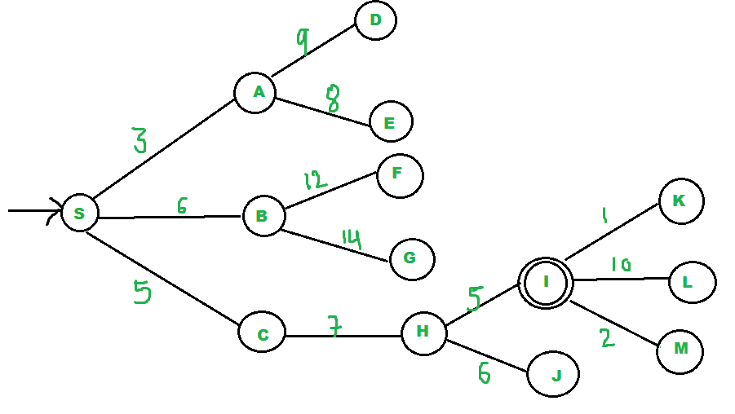
Best First Searching Techniques
Example

Slide 16
Best First Searching Techniques
Example
Start Position is S
Goal State is I
Start:
We start from source
“S” and search for goal “I” using
given costs and Best First search, pq initially contains S
Initially PQ = {S}

Slide 17
Best First Searching Techniques
We remove s from and
process unvisited neighbors
of S to pq.
Next, PQ = {A, C, B}
(C is put before B because C has
lesser cost)
Next, We remove A from pq and process unvisited neighbors of A to pq.
PQ = {C,B,E,D}

Slide 18
Best First Searching Techniques
Next,
We remove C from pq and
process unvisited neighbors
of C to pq.
PQ = {B,H,E,D}
Next , We remove B from pq
and process unvisited neighbors of B to pq
PQ = {H,E,D, F, G}
We remove H from pq.
Since our goal “I” is a neighbor of H, we return.

Slide 19
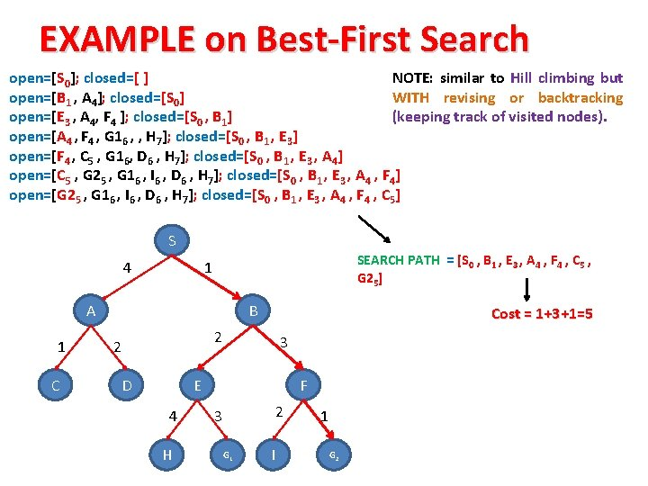
Best First Searching Techniques
Example - 2

Slide 20
Best First Searching Techniques
Example - 2

Slide 21
Best First Searching Techniques
Advantages
Best first search can switch between BFS and DFS by gaining the advantages of both the algorithms.
This algorithm is more efficient than BFS and DFS algorithms.
Disadvantages
It can behave as an unguided depth-first search in the worst case scenario.
It can get stuck in a loop as DFS.
This algorithm is not optimal.

